Slide 1
Pakistan Studies
Instructor Shamim Liaquat

Slide 2
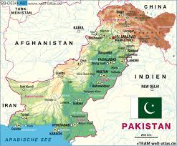
Geo Strategic Importance of Pakistan

Slide 3
Geo Strategic and Geo Politics
Geo refers to the Earth or Geography
Strategy means planning, tactics and policy
Strategic refers to the comprehensive and planned measures to achieve a central goal or to vital assets of military significance
Geo political reflects the combination of geographic and political factors determining the condition of a state or region.
Emphasizing the impact of geography on politics
Moreover, geographical significance of a country plays an important role in the world politics for that country.

Slide 4
Cont….
It marks that how critically beneficial is the country to the other countries in social, economic and political respects.
Geo-strategic merges strategic consideration with geopolitical ones
Geo-strategic means the importance of a country or a region as by virtue of its geographical location
Like NATO, Islamic Military Counter Terrorism Coalition (IMCTC) and Warsaw Pact is a geostrategic military alliance.

Slide 5
Geography of Pakistan
The Islamic republic of Pakistan is situated on a very important geographical location.
The mountainous region adjoining central Asia and the middle east.
In south Asia 2nd Atomic State
Area 796,096 Sq. km,
Pakistan is the world’s 33rd largest country

Slide 6
China Pakistan Economic Corridor
A part of belt and road initiative which is economic governances order.
It’s a game changer mega project for Pakistan and China as well.
Network of roads Kashgar to Persian Gulf via Gwadar and other part of country.
Industrial Zone
Railway
Pipeline
For China
Access to Persian gulf
Cheaper route
Check the US presence

Slide 7
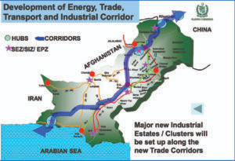
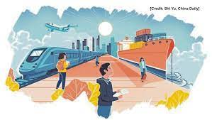

Slide 8
Gwadar Port
A warm water deep port
Central point of China Pakistan Economic Corridor
Chinese trade to the rest of world
Provides access to Central Asia
China’s energy requirements
Confluence of civilizations

Slide 9
Gate way to Central Asia
Central Asia is the center stage of new great games.
Because of energy resources and oil in the central Asia.
Pakistan is located very close to Central Asian states.
Pakistan can influence shipment of oil and to reach the central Asian states.
Iran is struggling to export its surplus gas and oil to Eastern countries, Qatar, Pakistan and Turkmenistan pipeline project highlight the position.
In this scare energy world, Pakistan can provide access from energy efficient to energy deficient state.

Slide 10
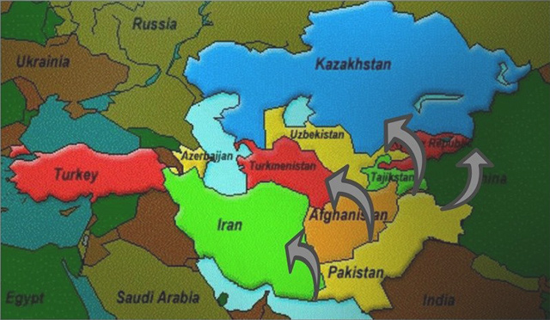
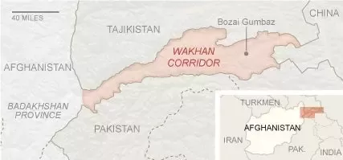

Slide 11
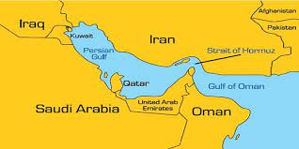
Persian Gulf
Gwadar port provides access to gulf of Oman.
This gulf is surrounded by U.A.E, Iran, Saudi Arabia, Bahrain, Qatar, Kuwait and Iraq.
Rich Energy Resources.
World Largest Natural Gas Reservoir.
Pakistan can check and facilitate the trade and transportation to gulf states.

Slide 12
Link to Islamic World
Geographically, Pakistan is situated at the Centre of the Islamic countries of Africa and Asia.
It is linked to these Muslim states through land and sea routes.
Thus not only its ideological background, but its geographical centrality that its support the unity of Muslim world.
Provide platform for the mutual alliance and unity of the Muslims.

Slide 13
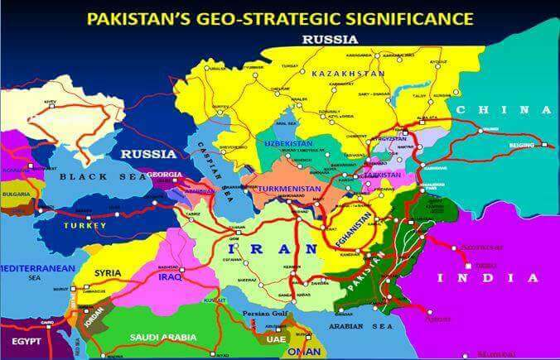
Pakistan & Muslim World

Slide 14
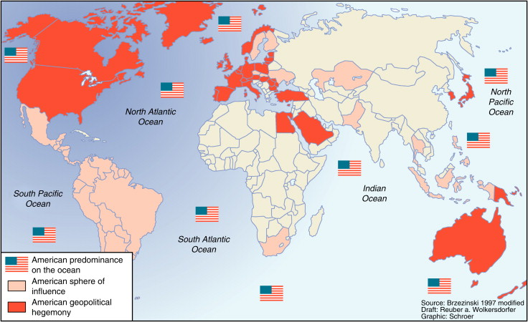
Indo U.S Hegemony in Indian Ocean
India has a shared interests with the U.S and NATO in the subjection of Pakistan.
Indian as Asian Tiger
String of pearls
Strait of Malaka and Hurmuz
From Gwadar check on Indo US activities.

Slide 15
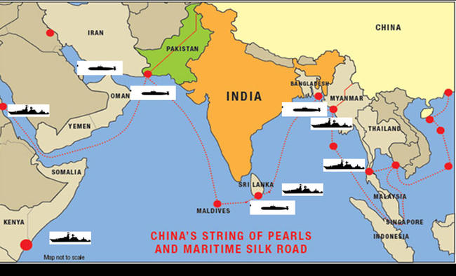
String of Pearls

Slide 16
Conclusion
Pakistan has a great geostrategic importance since its inception, its geography has been its greatest benefit.
It has resource rich area in the North-West, people in the north-east.
Pakistan is a junction of South Asia, West Asia and Central Asia, a way from resource efficient countries to resource deficient countries.
Pakistan can provide a platform for world to promote peace and prosperity.

Slide 17


Slide 18


